Slide 1
SIF
Service Integration Framework

Slide 2
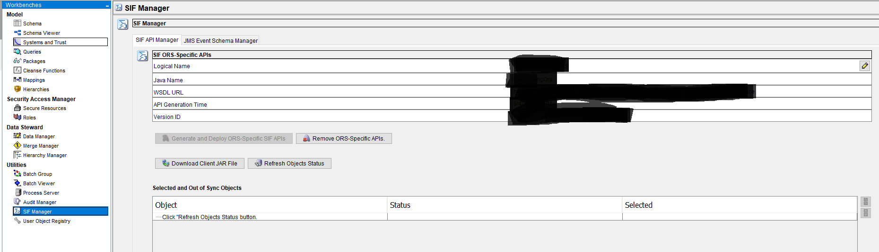
SIF is just an API
To Get SIF information
Utilities → SIF Manager
Click on “Generate and Deploy ORS specific SIF APIs

Slide 3
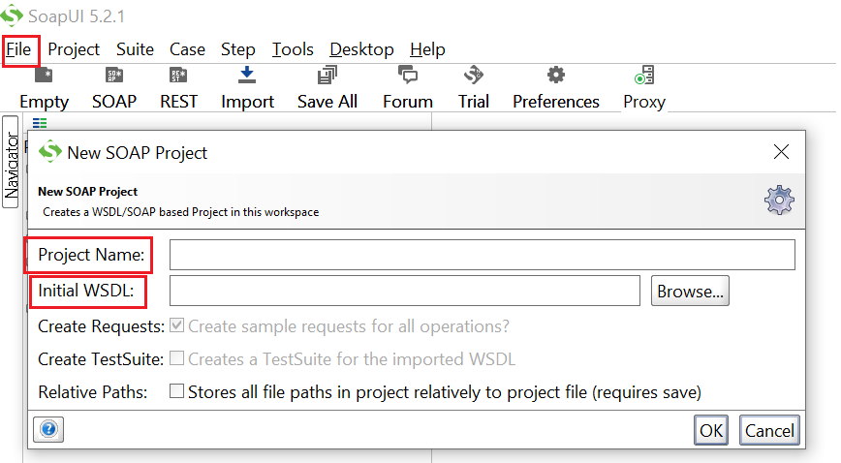
WSDL setup in SOAP to use SIF APIs

Slide 4
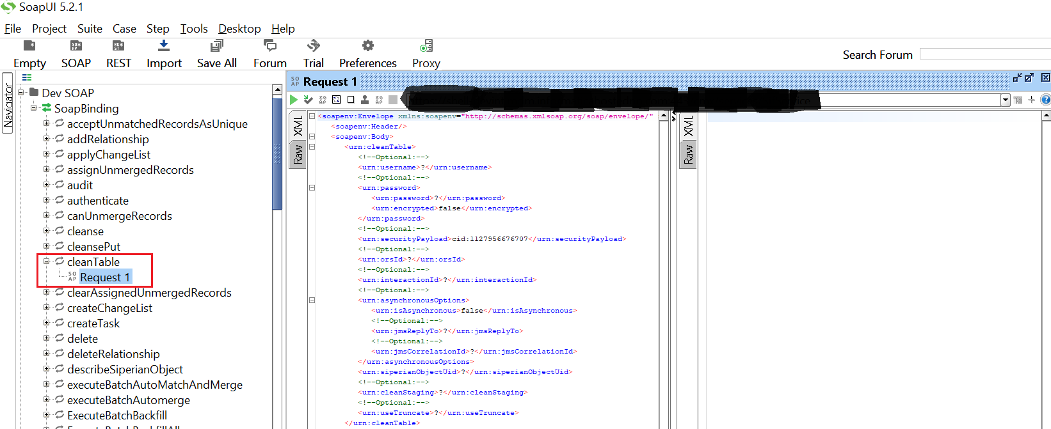
Clean Table SIF API to clean/truncate BO tables

Slide 5
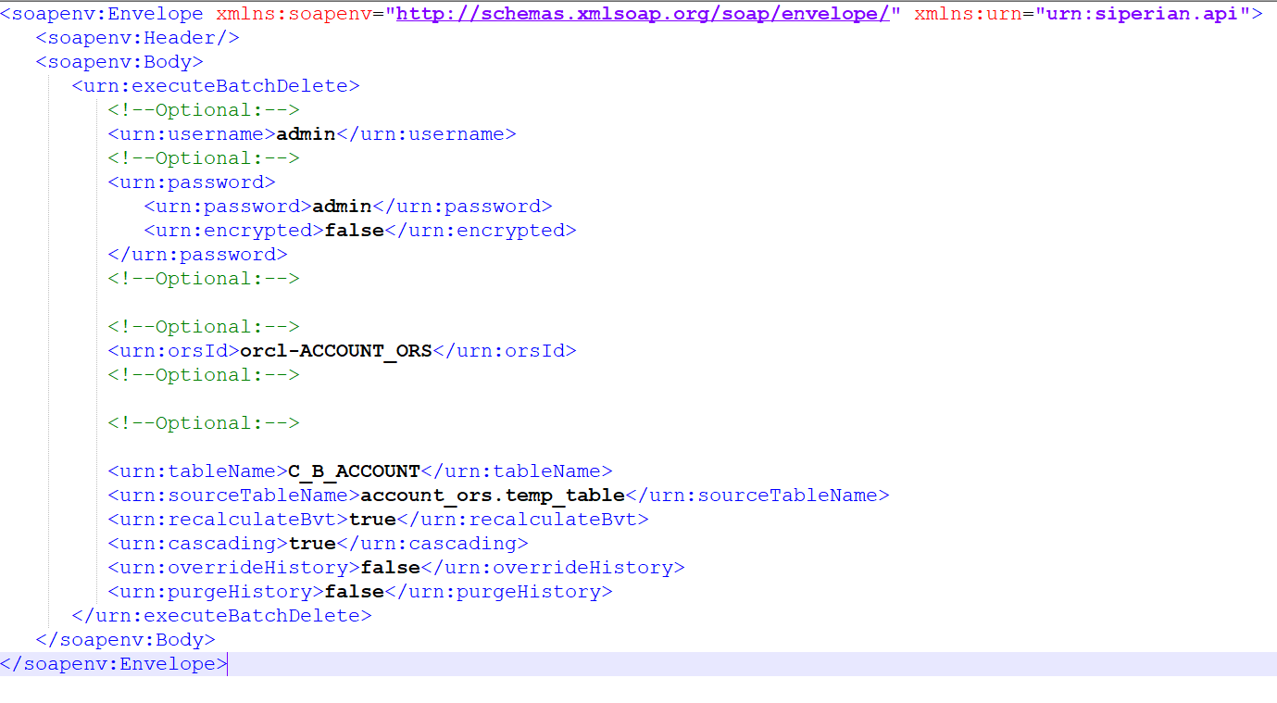

Slide 6
USER EXIT

Slide 7
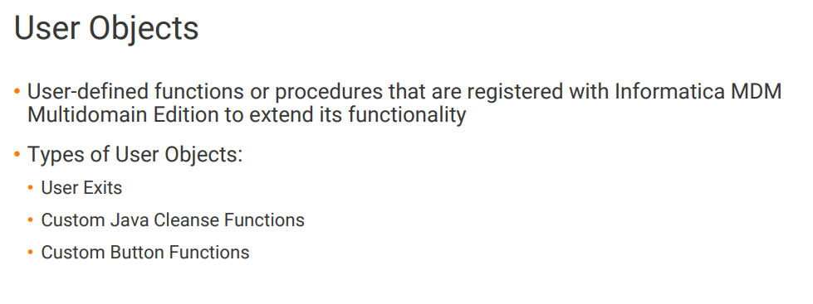

Slide 8
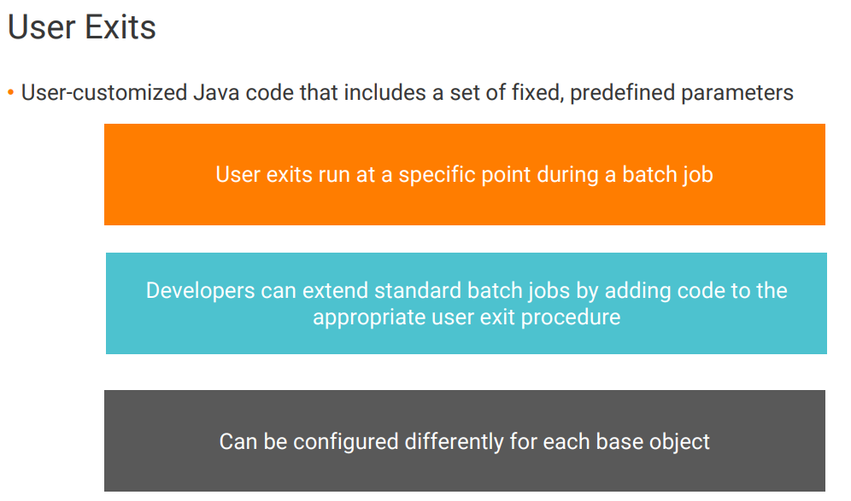

Slide 9
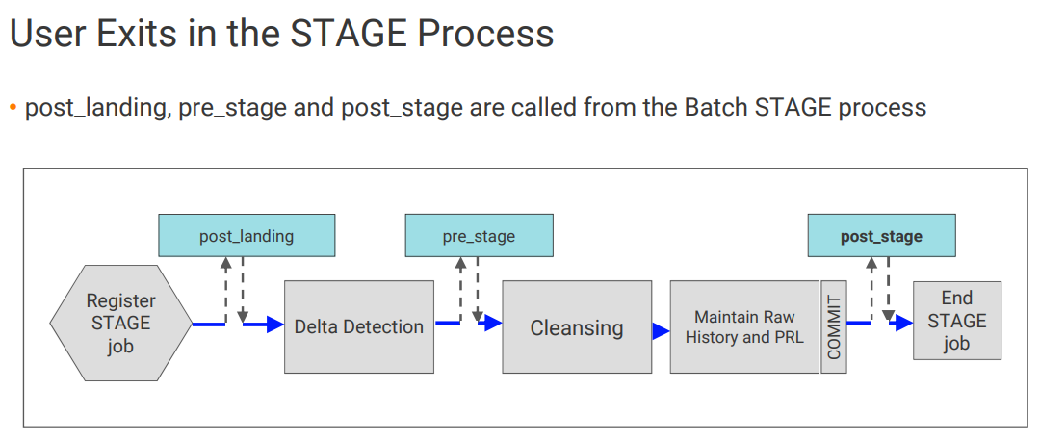

Slide 10
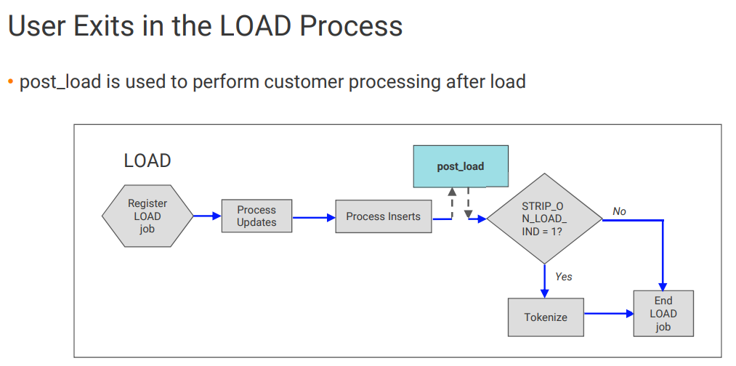

Slide 11
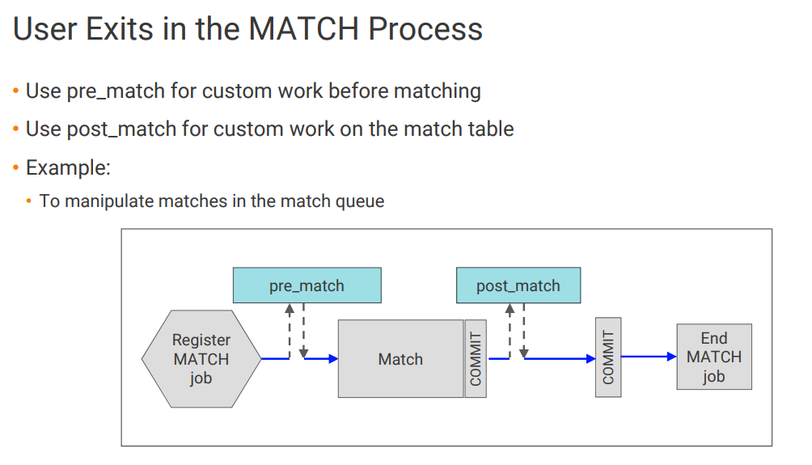

Slide 12
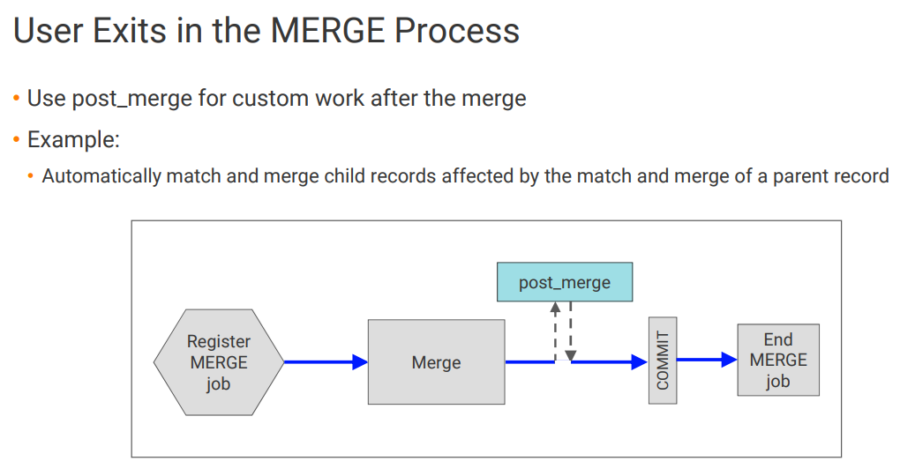

Slide 13
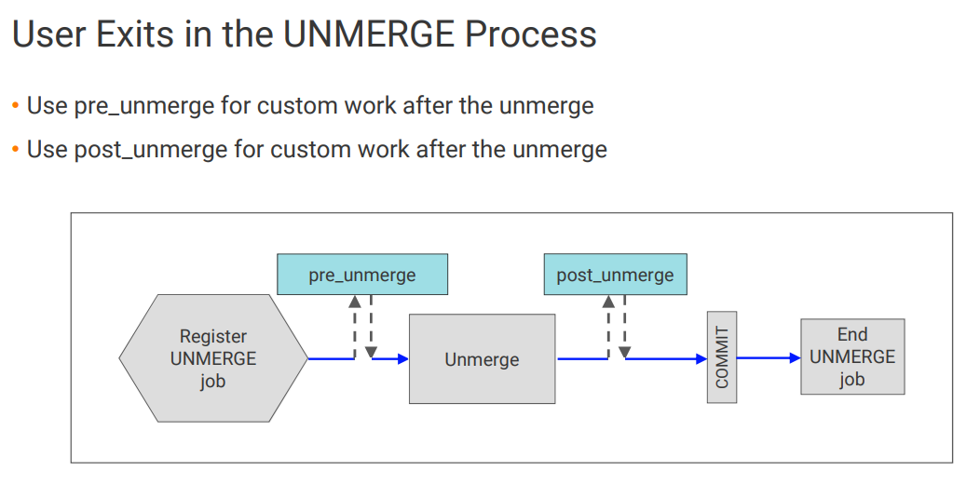

Slide 14
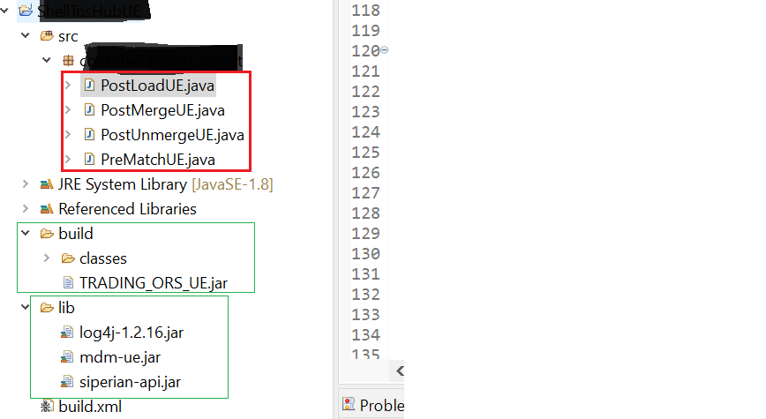
Sample UE code you will get in Resource Kit
Build and generate JAR file

Slide 15
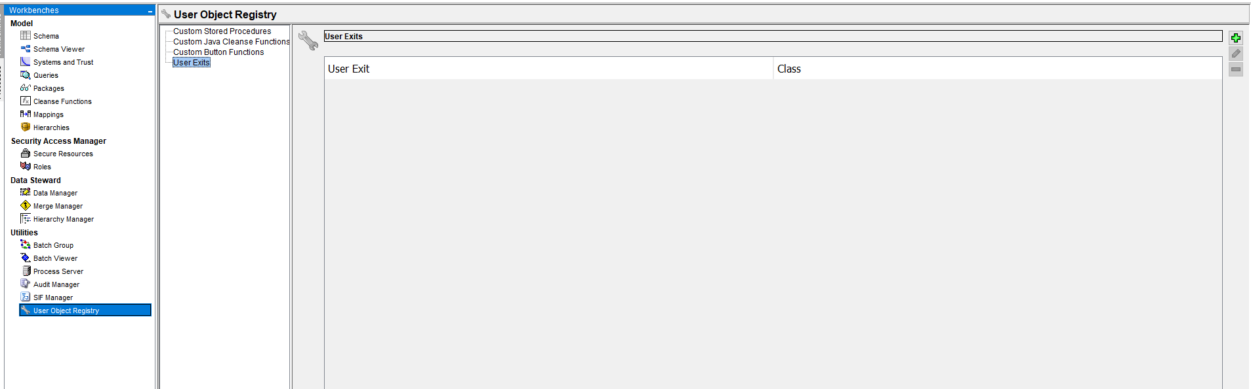
UE code deployment

Slide 16
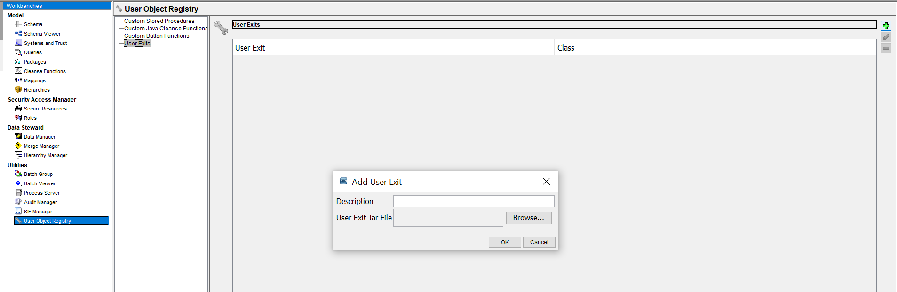

Slide 17
